Slide 1
Chennai – India 14 December 2019

Slide 2
ML Studio
@Chennai
Karthikeyan VK
MVP – Azure
@Karthik3030

Slide 3
Why ML Studio ?
Machine Learning Studio (classic) is where data science, predictive analytics, cloud resources, and your data meet.
One Stop Shop for all your Machine learning needs
Easy to learn
Tool build for Collaborative.
Provides drag-n-drop ML modules plus scalability, version control, and enterprise security.

Slide 4
What is ML Studio ?
ML Studio is a collaborative, drag-and-drop visual workspace where you can build, test, and deploy machine learning solutions without needing to write code.
It uses prebuilt and preconfigured machine learning algorithms and data-handling modules as well as a proprietary compute platform.

Slide 5
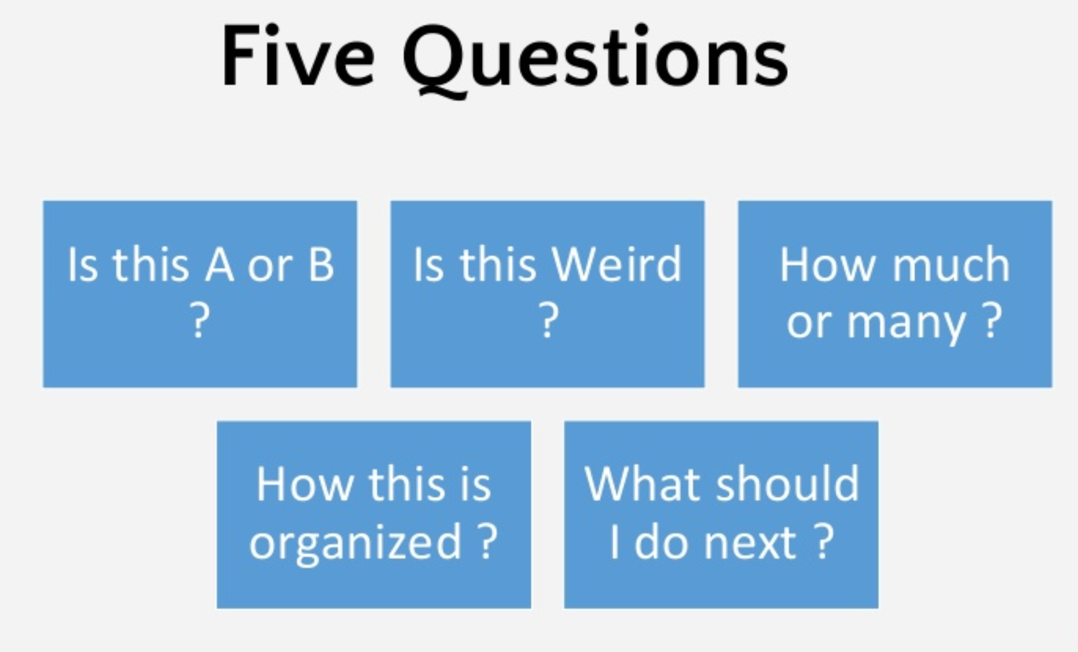

Slide 6
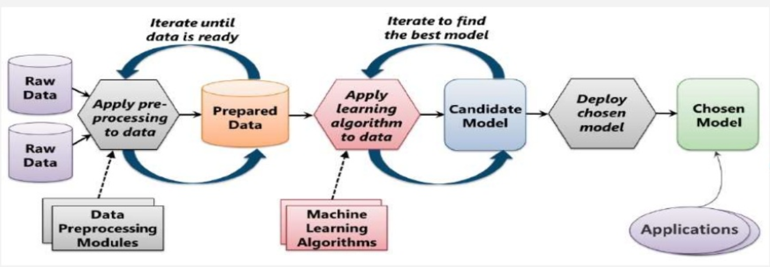
Process involved in Machine Learning

Slide 7
Step 1: Data Science Lifecycle
Business Understanding
Data Acquisition and Understanding

Slide 8
Step 2: Modeling
Identifying Features
Splitting the Data

Slide 9
Step 2: Modeling
Train the Model
Score the Test Data(Find Labels)
Evaluate the Model(Check the correctness of chosen algorithm)

Slide 10
ML Studio

Slide 11






Slide 12
Any Questions?

Slide 13
